Slide 1
Satisfiability Solvers
Part 2: Stochastic Solvers
600.325/425 Declarative Methods - J. Eisner

Slide 2
Methods in today’s lecture …
Can handle “big” random SAT problems
  Can go up about 10x bigger than systematic solvers! ☺
  Rather smaller than structured problems (espec. if ratio ≈ 4.26)
Also handle big structured SAT problems
  But lose here to best systematic solvers ☹
Try hard to find a good solution
  Very useful for approximating MAX-SAT
  Not intended to find all solutions
  Not intended to show that there are no solutions (UNSAT)
600.325/425 Declarative Methods - J. Eisner

Slide 3
Local search for SAT
Make a guess (smart or dumb) about values of the variables
Test how you are doing
Try flipping a variable to make things better
  Algorithms differ on which variable to flip
Repeat until
satisfied
600.325/425 Declarative Methods - J. Eisner

Slide 4
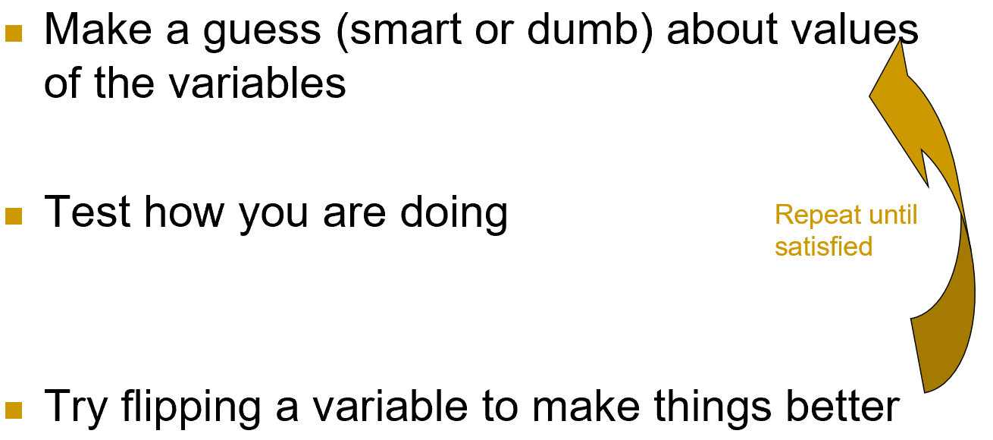
Local search for SAT
Flip a randomly chosen variable?
  No, blundering around blindly takes exponential time
  Ought to pick a variable that improves … what?
    Increase the # of satisfied clauses as much as possible
    Break ties randomly
    Note: Flipping a var will repair some clauses and break others
  This is the “GSAT” (Greedy SAT) algorithm (almost)
600.325/425 Declarative Methods - J. Eisner

Slide 5
Local search for SAT
Flip most-improving variable. Guaranteed to work?
What if first guess is A=1, B=1, C=1?
  2 clauses satisfied
  Flip A to 0 ➔ 3 clauses satisfied
  Flip B to 0 ➔ all 4 clauses satisfied (pick this!)
  Flip C to 0 ➔ 3 clauses satisfied
A v C
A v B
~C v ~B
~B v ~A
600.325/425 Declarative Methods - J. Eisner
example thanks to Monaldo Mastrolilli and Luca Maria Gambardella

Slide 6
Local search for SAT
Flip most-improving variable. Guaranteed to work?
But what if first guess is A=0, B=1, C=1?
  3 clauses satisfied
  Flip A to 1 ➔ 2 clauses satisfied
  Flip B to 0 ➔ 3 clauses satisfied
  Flip C to 0 ➔ 3 clauses satisfied
  Pick one of B or C… (picking A wins on next step)
A v C
A v B
~C v ~B
~B v ~A
600.325/425 Declarative Methods - J. Eisner
example thanks to Monaldo Mastrolilli and Luca Maria Gambardella

Slide 7
Local search for SAT
Flip most-improving variable. Guaranteed to work?
But what if first guess is A=0, B=1, C=1?
  3 clauses satisfied
  Flip A to 1 ➔ 2 clauses satisfied
  Flip B to 0 ➔ 3 clauses satisfied
  Flip C to 0 ➔ 3 clauses satisfied
  Pick one of B or C
A v C
A v B
~C v ~B
~B v ~A
600.325/425 Declarative Methods - J. Eisner
example thanks to Monaldo Mastrolilli and Luca Maria Gambardella
Notes:
We flip B:
The assignment becomes A=0,B=0,C=1
Which clauses are now satisfied: clause 1, clause 3, clause 4
So, only 3 clauses satisfied out of 4.
We need to do another flip
Let’s check all of the flips:
Flip A to 1: clauses 1, 2, 3, 4 are all satisfied: (4 clauses)
Flip B to 1: clause 1,2,4 (3 clauses)
Flip C to 0: clause 3,4 (2 clauses)
So: pick flip A=1, then the assignment becomes A=1,B=0, C=1, 4 clauses satisfied, we are done!!!

Slide 8
Local search for SAT
Flip most-improving variable. Guaranteed to work?
Yes for 2-SAT: probability → 1 within O(n²) steps
No in general: can & usually does get locally stuck
Therefore, GSAT just restarts periodically
  New random initial guess
600.325/425 Declarative Methods - J. Eisner
example thanks to Monaldo Mastrolilli and Luca Maria Gambardella

Slide 9
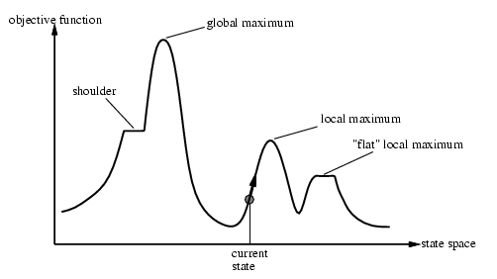
Problems with Hill Climbing
600.325/425 Declarative Methods - J. Eisner
slide thanks to Russ Greiner and Dekang Lin

Slide 10
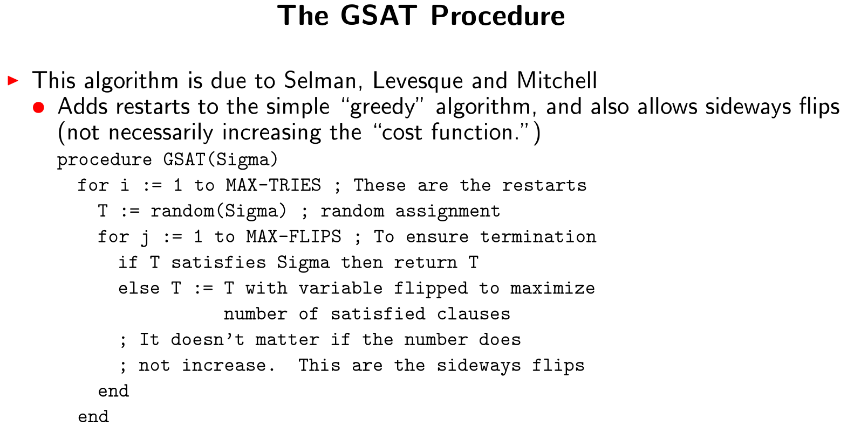
Believe it or not, GSAT outperformed everything else when it was invented in 1992.
600.325/425 Declarative Methods - J. Eisner

Slide 11
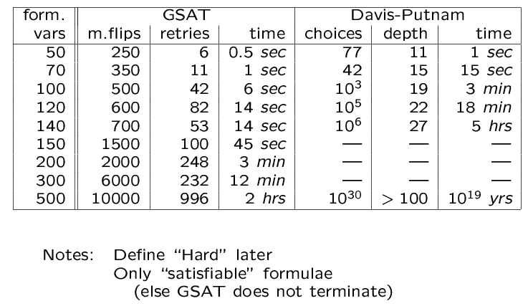
GSAT vs. DP on Hard Random Instances
600.325/425 Declarative Methods - J. Eisner
slide thanks to Russ Greiner and Dekang Lin

Slide 12
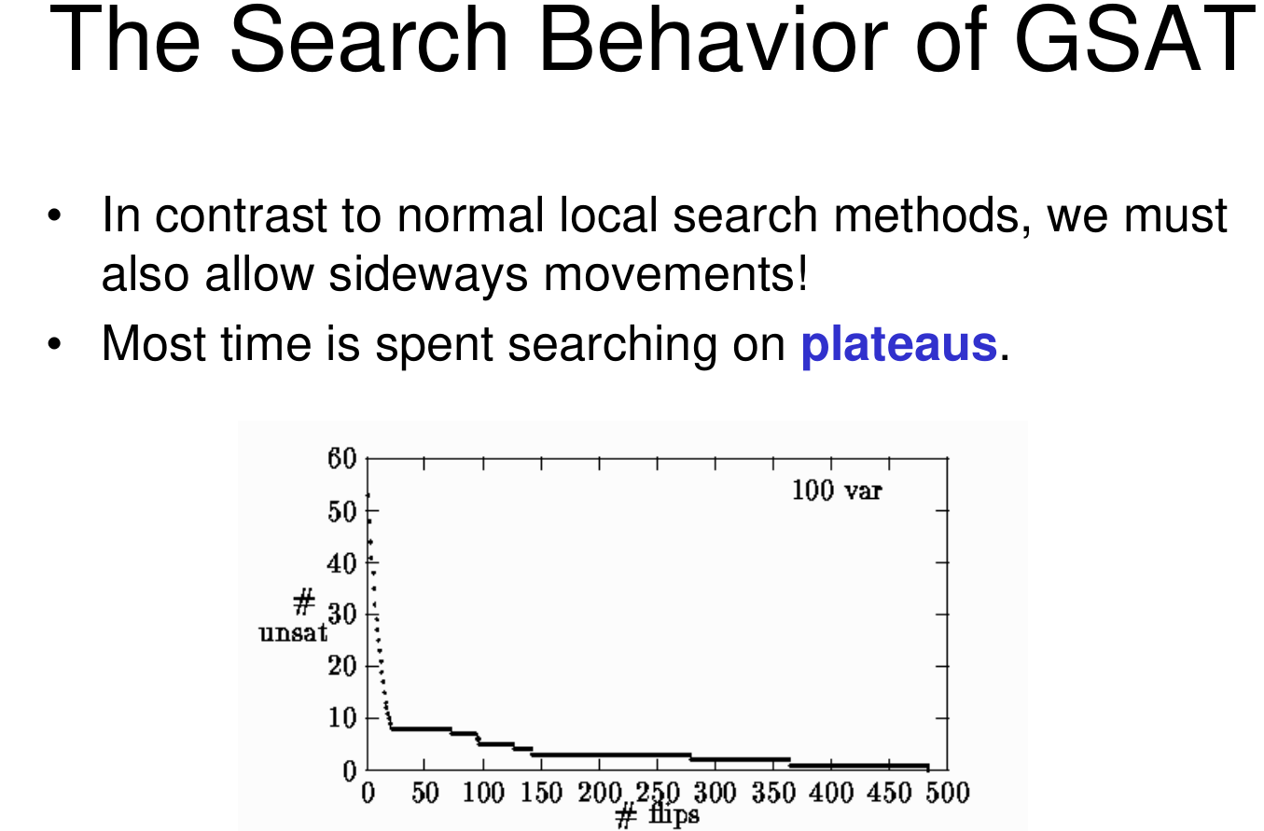
600.325/425 Declarative Methods - J. Eisner

